Slide 1
Semester 1.2 Clinical Methods II
40 Hours modules with consisting of 24 hours theory and 16 hours practical in the skills lab.
Per abdomen examination 6; 4 hours
GUT 4: 4 hours
Musculoskeletal system 4: 4 hours
Nervous system 10: 4 hours

Slide 2
Systemic Examination of the Genital Urinary System
Introduction
The GUT consist mainly the genital organs and the urinary tract/system.
The genital organs involve the urinary and reproductive system.
The two in general practice are examined together because they are anatomically related and embryology the originate from the site of urogenital sinus.
Physiologically they are also related in their functions and in that when one organ has pathological or anatomical problem it will tend to affect the other

Slide 3
History taking
Enquire about the symptoms of the urinary and the reproductive system since any of them will tend to affect the other.
Symptoms of urinary system to enquire in history taking
Dysuria
Amount of urine
Polyuria
Hesitancy
Frequency
Incontinence

Slide 4
cont
Stream of urine- normal or poor and its characteristics.
Hematuria
Color of urine- normal Straw color
Polyuria
Pyuria
Urine retention
Lower abdominal pains
Lower limbs swellings
Face swelling with periorbital swelling

Slide 5
cont
Reproductive system
Female
Hair distribution -
Normal and abnormal per vaginal discharge- color, amount, consistence, smell and for how long.
Per vaginal bleeding- normal or abnormal, color, consistence, amount,
Genital itchiness
Genital ulcers- (GUDs)
Genital swellings – growth, Bartholin abscess, Bartholin cyst, labial abscess, Warts, keloids etc
Congenital anomalies: Labia fusion, infantile genitalia, hermaphrodites

Slide 6
cont
Sexual history (symptoms to enquire )
Sexually active
Last Sexual contact
Dyspauranea
Libido-sexual urge
Sexual satisfaction
Sex partners- single or multiple
Sexual deviations
Safe sex practices

Slide 7
cont
Male
Hair distribution
Urethral discharge
Scrotal pains
Penile pains
Testicular pains
Scrotal swellings- abscess, cyst, tumour, varicosity,
Genital warts
Genital warts

Slide 8
cont
Libido -Sexual urge
Sexual satisfaction
Ejaculation- premature, retrograde or lack of ejaculation
Impotence – partial or complete
Congenital anomaly – hypospandias – urathral opening underside the penis and epispandia –opening on top of the penis.

Slide 9
Inspection
Done when indicated in both male and female
In female digital vaginal examination either Gynecological and obstetrical is done for:
Investigations
pelvic assessment
Cervical assessment/Bishop score
Speculum examination-indications ; draining of liquor, APH, HVS, Genital warts, PPH, Abortion, PAP Smear, etc

Slide 10
cont
Prepare the patient by explaining the procedure.
Obtain a consent from the patient
Ensure patient bladder is empty
Place the patient in the lithotomy position if female and male can lie on spine position.
Observe infection prevention by ensure general precaution
Drape the patient.

Slide 11
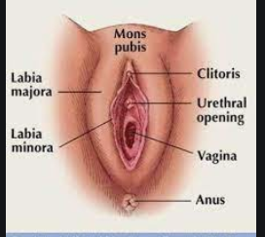
Female external genitalia anatomy

Slide 12
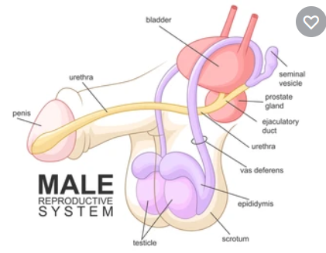
Male external genitalia anatomy

Slide 13
cont
Inspection: check for
Hair distribution
Warts,
Abnormal discharge,
Ulcers- GUD
Bleeding ,
Scars
Swelling
Sores
FGM

Slide 14
cont
Congenital abnormality – epispadia, hypospadias, streak gonads, labia fusion, vaginal agenesis, hermaphroditism. Turners syndrome
Sexual abuse.
Imperforate hymen
Undeveloped penis/ critoris
Male circumcision

Slide 15
Palpation
Tenderness –genitals
Labial masses
Genital swellings
Testicular masses
Digital vaginal examination
Testis to find out if two on one.
Perform illumination test incase of scrotal swelling to assess evidence of hydrocele.(scrotal fluid)

Slide 16
cont
Auscultation
Listen for Bowel sound incase of inguinal or scrotal inguinal hernia.
Auscultate for cough reflex.

Slide 17
Investigations of GUT
TBC
Urinalysis
Urethral swab for culture and sensitivity
HVS for gram stain, culture
Biopsy
Ultrasound
MCU
IVU
MRI
X.RAY
Endoscopy
Speculum

Slide 18
Practical skills
Digital vaginal examination
Speculum Vaginal examination
Catheterization –male and female
Suprapubic puncture and catheterization
Urine sample collections.

